Slide 1
In this lecture, you will learn:
Why data models are important
About the basic data-modeling building blocks
Database Systems 6e / Rob & Coronel
2- <number>

Slide 2
The Importance of Data Models
Data model
  Relatively simple representation, usually graphical, of complex real-world data structures
  Communications tool to facilitate interaction among the designer, the applications programmer, and the end user
Good database design uses an appropriate data model as its foundation
Database Systems 6e / Rob & Coronel
2- <number>

Slide 3
Importance of Data Modeling
End-users have different views and needs for data
Data model organizes data for various users
Database Systems 6e / Rob & Coronel
2- <number>

Slide 4
Data Model Basic Building Blocks
Entity is anything about which data are to be collected and stored
Attribute is a characteristic of an entity
Relationship describes an association among (two or more) entities
  One-to-many (1:M) relationship
  Many-to-many (M:N or M:M) relationship
  One-to-one (1:1) relationship
Database Systems 6e / Rob & Coronel
2- <number>

Slide 5
Business Rules
Brief, precise, and unambiguous description of a policy, procedure, or principle within a specific organization’s environment
  A company airplane must be inspect after 15 hours of flight time
  A customer may generate many invoices
  Each invoice is generated by only one customer
Apply to any organization that stores and uses data to generate information
Database Systems 6e / Rob & Coronel
2- <number>

Slide 6
A Good Business Rule is:
Declarative – what, not how
Precise – clear, agreed-upon meaning
Atomic – one statement
Expressible – structured, natural language
Distinct – non-redundant
Business-oriented – understood by business people

Slide 7
The Evolution of Data Models
Hierarchical
Network
Relational
Entity relationship
Object oriented
Database Systems 6e / Rob & Coronel
2- <number>

Slide 8
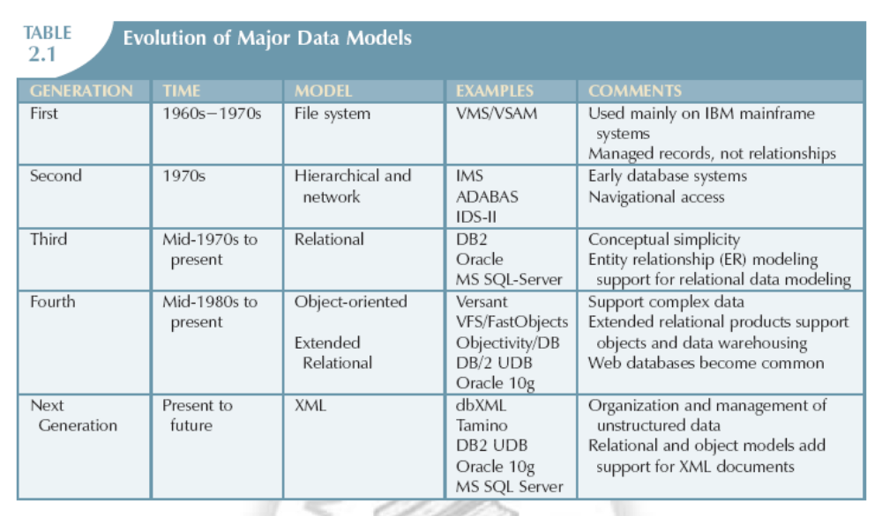
Evolution of Major Data Models
Database Systems 6e / Rob & Coronel
2- <number>

Slide 9
The Entity Relationship Model
Widely accepted and adapted graphical tool for data modeling
Introduced by Peter Chen in 1976
Graphical representation of entities and their relationships in a database structure
Database Systems 6e / Rob & Coronel
2- <number>

Slide 10
The Entity Relationship Model—
Basic Structure
Entity relationship diagram (ERD)
  Uses graphic representations to model database components
  Entity is mapped to a relational table
Entity instance (or occurrence) is row in table
Entity set is collection of like entities
Connectivity labels types of relationships
  Diamond connected to related entities through a relationship line
Database Systems 6e / Rob & Coronel
2- <number>

Slide 11
The Entity Relationship Model—
CrowFoot Components
Database Systems 6e / Rob & Coronel
2- <number>

Slide 12
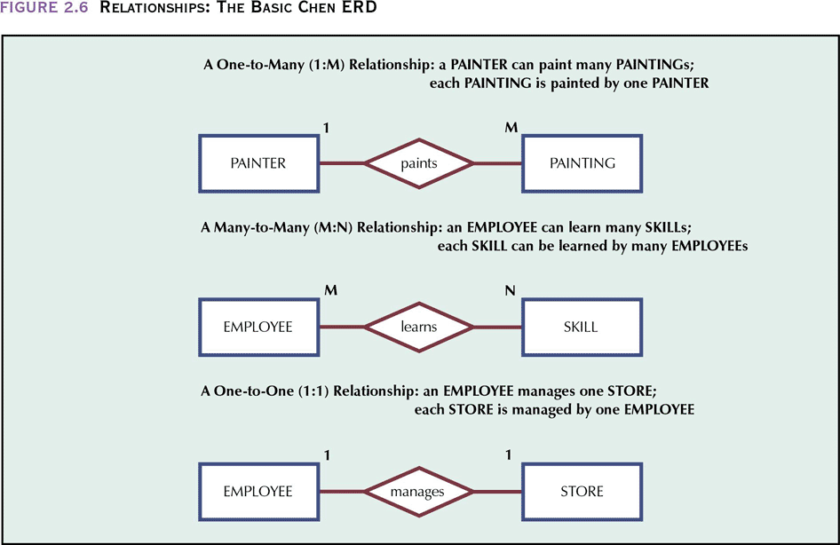
Relationships: The Basic Chen ERD
Database Systems 6e / Rob & Coronel
2- <number>

Slide 13
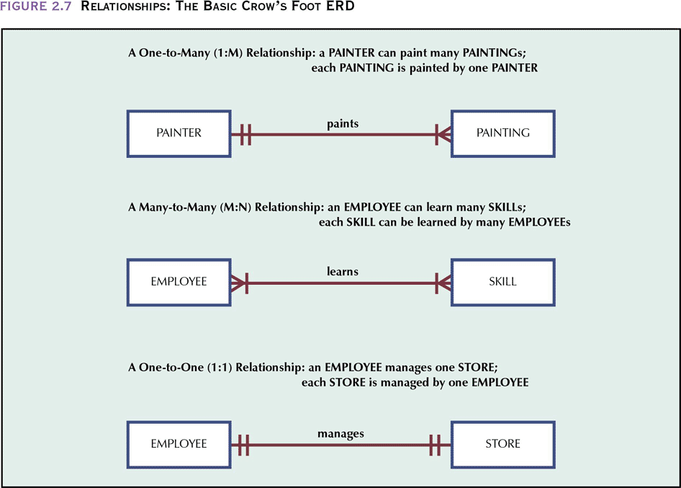
Relationships:
The Basic Crow’s Foot ERD
Database Systems 6e / Rob & Coronel
2- <number>

Slide 14
The Entity Relationship Model
Advantages
  Exceptional conceptual simplicity
  Visual representation
  Effective communication tool
  Integrated with the relational data model
Database Systems 6e / Rob & Coronel
2- <number>

Slide 15
The Entity Relationship Model
Disadvantages
  Limited constraint representation
  No data manipulation language
Database Systems 6e / Rob & Coronel
2- <number>

